Slide 1

Fitway App using Flutter
RNS INSTITUTE OF TECHNOLOGY
BENGALURU - 98
DEPARTMENT OF INFORMATION SCIENCE & ENGINEERING
Presentation on Internship
Saurav R Shetty
USN: 1RN18IS095
ENMAZ Engineering Services Pvt. Ltd.
Internal Guide
Dr. Suresh L
Prof. & HOD, Dept of ISE, RNSIT
External Guide
Mr. Akshay DR
ENMAZ

Slide 2
AGENDA
Abstract
About the Company
Introduction
Literature Survey
Requirements
System Design
Detailed Design
Implementation
Testing
Conclusion and Future Enhancements
References
Q & A

Slide 3
About the Company
Enmaz Engineering Pvt. Ltd is a Service based company founded in the year 2019.
It specializes in
Embedded H/W Development
Embedded Firmware Development
Cloud support
Big Data Analysis and Reporting
Dashboard UX/UI design and development
Model Analysis.

Slide 4
ABSTRACT
Over recent years the world has seen a spike in the download and usage of fitness and health apps. In 2014 fitness app usage grew at a substantial rate, being up there as the most used category of application for that year. Since then it has maintained its user base and continues to grow, with the inclusion of wearables like google fit, Fitbit and HealthKit. This is the dawn of a new era, an era where people look more to their mobiles or their fitness watches to check on their health, rather than the traditional method of going and seeing a doctor. These apps provide a great avenue for those who are interested on tracking their fitness levels runners, cyclists, and gym goers alike. Everything can be tracked nowadays, even the standard iPhone comes with a health app built in, with a range of features.

Slide 5
INTRODUCTION
The purpose of my application is to develop an application that is valuable to gym goers and people who exercise in general who would like to track their workouts and accomplish their fitness goals. The graphical user interface of the app should look appealing to the user so as to entice them. The app should provide a pleasant experience and a provide a feeling of accomplishment after being used to encourage recurrent usage.
It should be highly accessible regardless of the user’s familiarity with applications. Whether the user is a novice or is experienced, the app will be good for both. The key to this app is simplicity and this app will provide a few features popular in this market, through a simple and straight to the point application. The app should also provide the user with a fun experience.

Slide 6
The popular features I have aimed to include in this application are;
1. A stopwatch – A simple stopwatch for interval training when working out. A workout planner -A simple workout planner which allows you to add and delete workout routines.
2. Catalogue – A catalogue of workouts for different body parts depending on what the user wants to target on.

Slide 7
Requirements
The Hardware requirements are very minimal and the program can be run on most of the machines.
Processor : Pentium 4 Processor
Processor Speed : 2.4 GHz
RAM : 2 GB
Storage Space : 40 GB
The software requirements are very minimal and the program can be run on the machines with these requirements satisfied:
Editor : Visual Studio Code
Operating System : Windows / Mac OS
IDE : VS Code / Flutter
Backend Tool : JSON

Slide 8
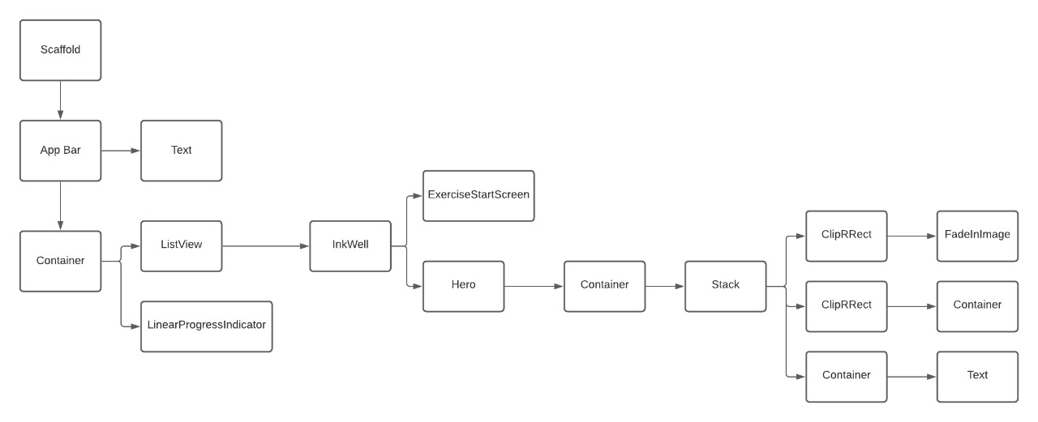
System Design
Widget Tree for Home page

Slide 9
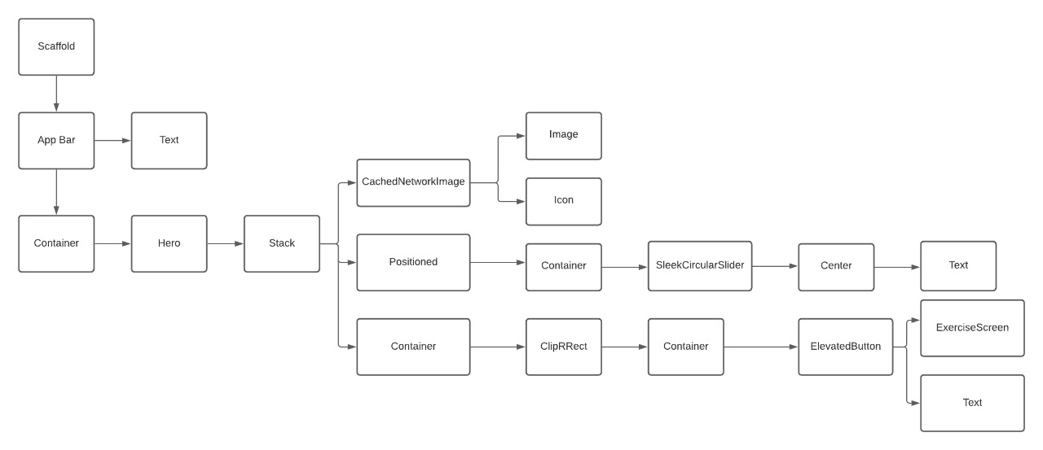
Widget Tree for Exercise Start Screen

Slide 10
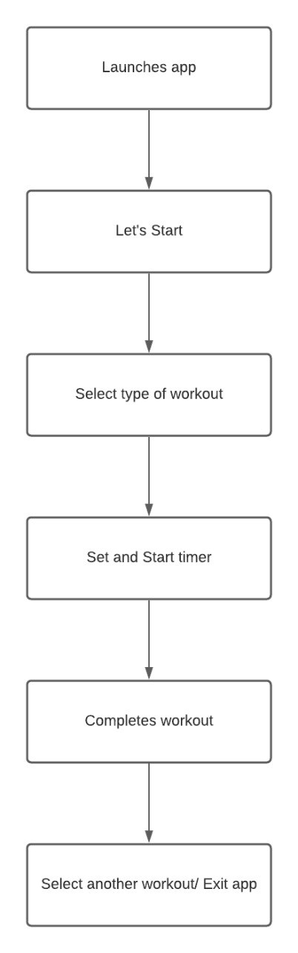
Implementation / Coding

Slide 11
import 'package:fitness_app/screens/onboarding_screen.dart';
import 'package:flutter/material.dart';
void main() {
runApp(const MyApp());
}
class MyApp extends StatelessWidget {
const MyApp({Key? key}) : super(key: key);
// This widget is the root of your application.
@override
Widget build(BuildContext context) {
return const MaterialApp(
debugShowCheckedModeBanner: false,
title: 'Flutter Demo',
home: OnboardingScreen(),
);
}
}
class MyHomePage extends StatefulWidget {
const MyHomePage({Key? key, required this.title}) : super(key: key);
final String title;
@override
State<MyHomePage> createState() => _MyHomePageState();
}
class _MyHomePageState extends State<MyHomePage> {
int _counter = 0;
void _incrementCounter() {
setState(() {
_counter++;
});
}
main.dart

Slide 12
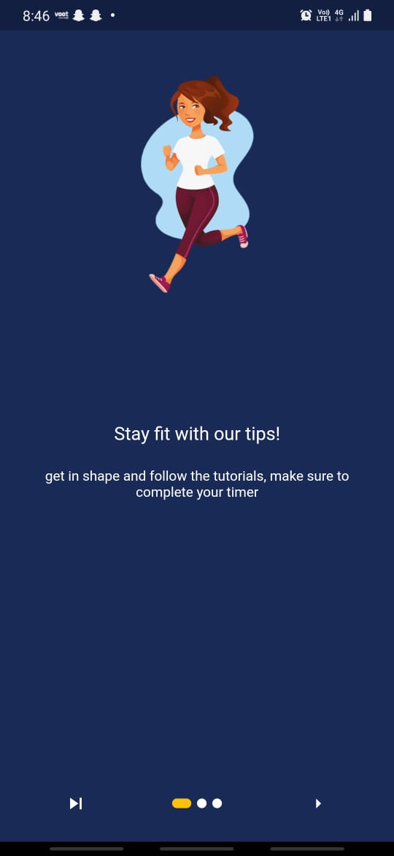
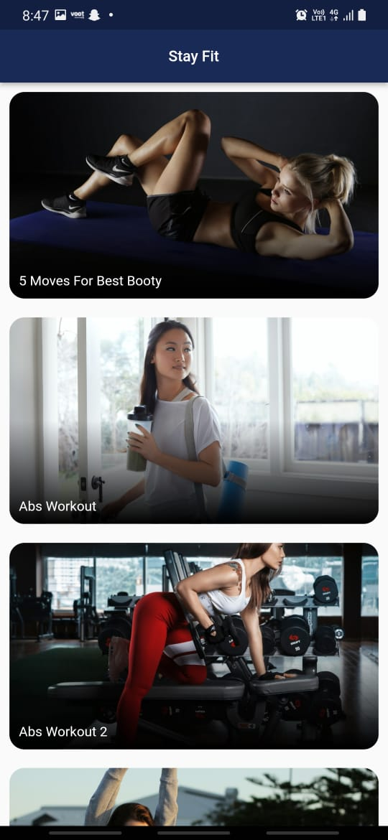
RESULTS
Onboarding Screen: This screen onboards the customers into the app while painting a general image of what to expect in the main screen. It also displays a few quotes in three different slides and screens to give encouragement in the motivational sense to exercise and stay fit.
Home Page: The On-Boarding screen leads next to the home page which contains a catalogue of exercises targeting specific body parts depending on the user wants to target for that particular workout session.

Slide 13
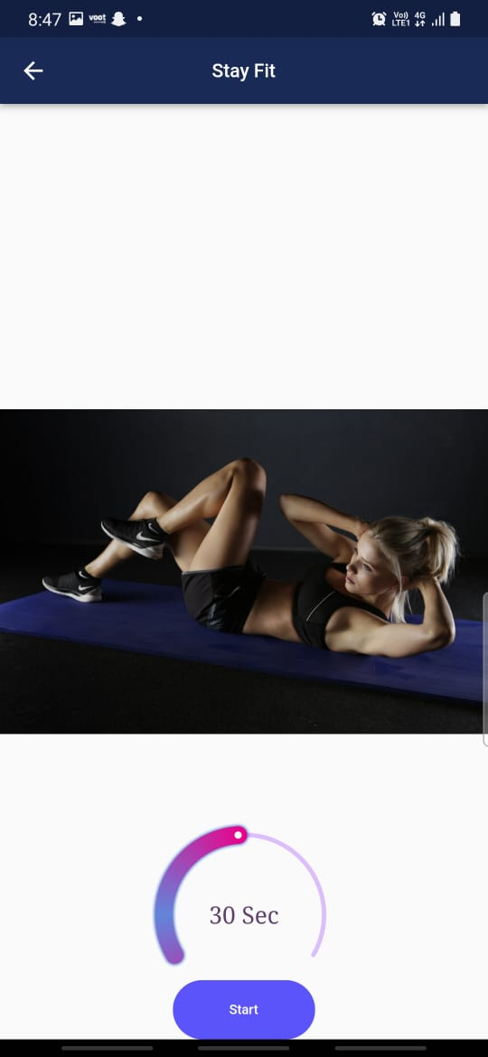
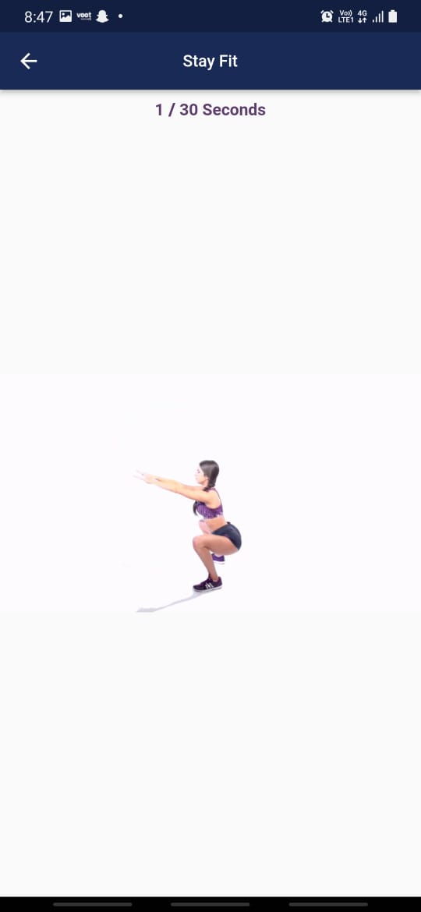
Exercise Start Screen: This page allows us to set the timer for the particular workout routine and start the exercise.
Exercise Screen: This screen shows a gif of the complete exercise in proper form so that the user can follow along with it and each exercise is performed for the time that was set by the user in the previous screen. Once the whole workout is completed, there’s a “cheers from the audience” indication, which serves as an appreciation note and also indicates that the workout is complete.

Slide 14
CONCLUSIONS
This report gives an insight into the background as to why I chose to develop this application. I believed that there was a problem with apps of this type and that if done a certain way this could be solved. The idea and my motivations have been stated clearly. The requirements are described in detail and the technologies used have also been outlined in this document. I believe that I achieved most of what I have set out to do when this idea was conceived. However, there are multiple different areas which could be improved and lots of room for expansion.

Slide 15
Future Enhancements
In the future, this application could be greatly improved and expanded to include new features :
The tracker and step counter can be improved.
A calorie counter could be added to allow users keep track of their daily intake and pursue their weight loss goals. This would mean populating a database with vast amounts of food and nutritional data and allowing the user to enter food eaten after every meal. Once entered the app takes the number of calories from their daily allowance.
An exercise instruction manual which advises users of exercises and how to do them.

Slide 16
REFERENCES
https://rubygarage.org
www.hackernoon.com
www.ncbi.nlm.nih.gov
www.ispo.com
Adria Muntaner-Mas, Antonio Martinez-Nicolas, Carl J. Lavie, Steven N. Blair, Robert Ross, Ross Arena, and Francisco B. Ortega (2019). A Systematic Review of Fitness Apps and Their Potential Clinical and Sports Utility for Objective and Remote Assessment of Cardiorespiratory Fitness. Sports Medicine 2019, 49(4), 587-600. doi:10.1007/s40279-019-01084-y
www.github.com
www.stackoverflow.com

Slide 17
THANK YOU

